Slide 1

Worldwide Economic Trends: Insights and Opportunities
A comprehensive analysis of global economic indicators to understand development patterns and trends across regions.

Slide 2





Agenda
Project Idea & Audience
The foundation and target demographic of analysis
Dataset & Research Questions
Data sources and key economic inquiries
Data Exploration & Analysis
Methodology and analytical approach
Visualizations & Conclusion
Illustrating findings and their implications

Slide 3

Project Idea
Overview
Goals
Analyze global economic indicators to understand development patterns and trends worldwide.
Provide comprehensive analysis of economic indicators across regions and timeframes.
Importance
Crucial for formulating effective development policies and addressing regional disparities.

Slide 4

Audience
4
100+
Key Groups
Countries
Policymakers, researchers, economists, and economics students
Global audience spanning developed and developing nations
3
Decision Levels
Local, national, and international policy applications

Slide 5
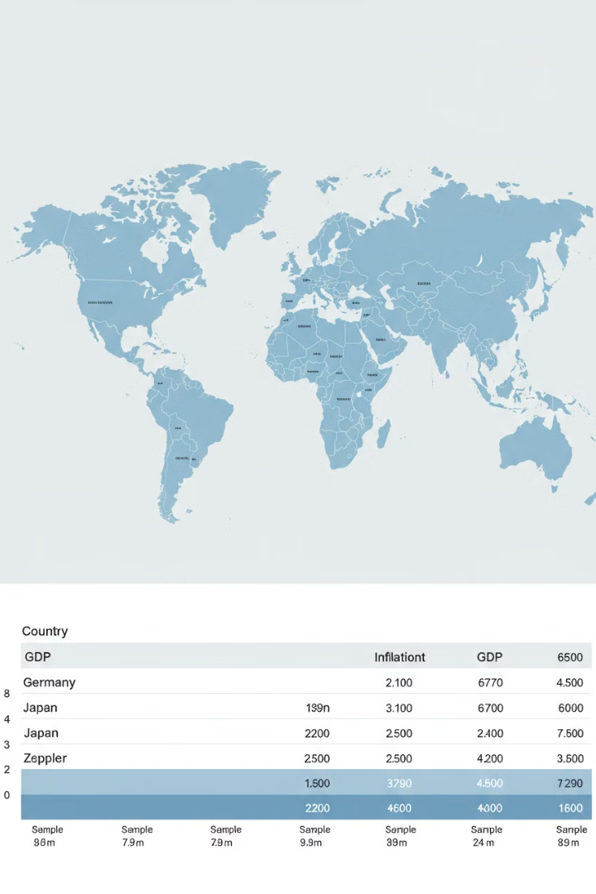



Dataset Overview
World Bank Data
5,105 records with 25 features across 1.62 MB
Economic Indicators
GDP, education expenditure, health metrics, trade percentages
Global Coverage
Comprehensive collection of worldwide development data

Slide 6






Task
Key Insight
Identify factors influencing economic growth across regions
Key Takeaway
Gain understanding of economic dynamics for development
Objective
Analyze and visualize global economic indicators and trends

Slide 7





Research Questions
Growth Drivers
What are the main drivers of economic growth across different regions?
Human Capital
How do education and healthcare investments correlate with development?
Policy Impacts
What is the impact of trade policies on growth and development outcomes?
Infrastructure Effects
How does infrastructure investment affect regional economic disparities?

Slide 8

Data Exploration
Dataset Structure
Thoroughly explored data structure and contents
Data Cleaning
Handled missing values, duplicates, and standardized formats
Challenge Resolution
Overcame data inconsistencies through appropriate techniques

Slide 9





Data Analysis
Tools
Python with Pandas, NumPy, GeoPandas, and Matplotlib
Process
Cleaning, preprocessing, and normalizing economic data
Derivations
Calculated metrics like GDP per capita and trade balance
Insights
Identified economic trends and regional development disparities

Slide 10
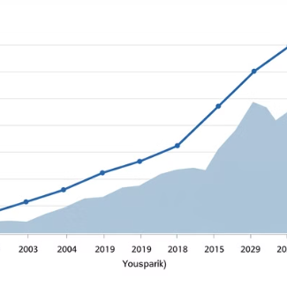
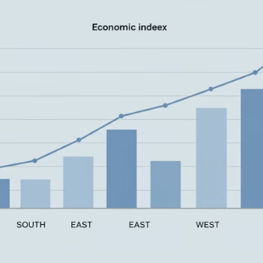
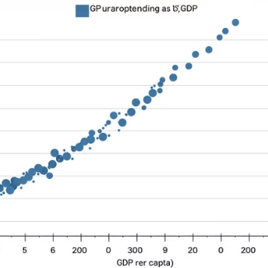
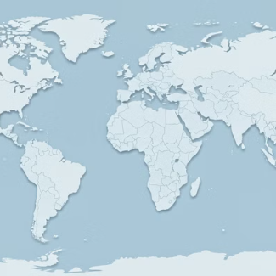
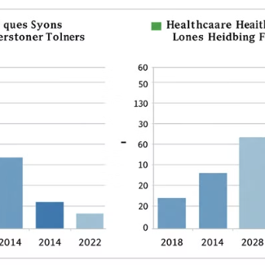
Visualizations
Visualizations employ charts, graphs, and maps to illustrate economic trends and patterns across regions and time periods.

Slide 11
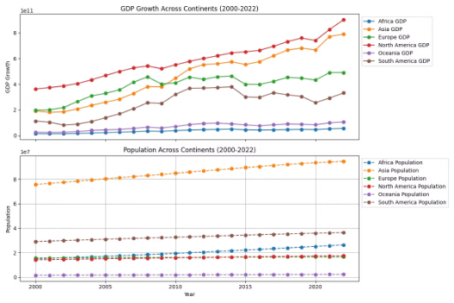
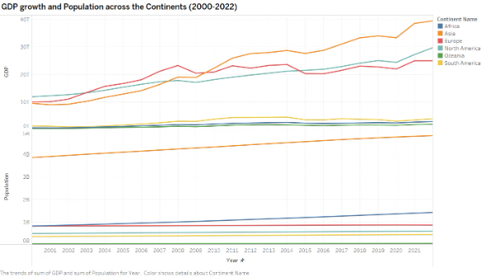
Line Chart Analysis
GDP Growth Trends
Population Changes
Line charts reveal fluctuating economic growth patterns across regions. The visualization highlights recovery periods after global downturns.
Demographic shifts show varied patterns by region. Developing regions display steeper population growth curves compared to developed regions.

Slide 12
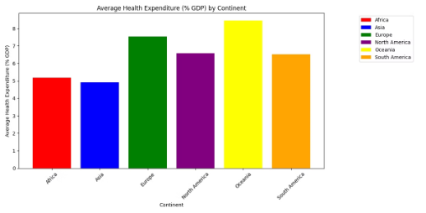
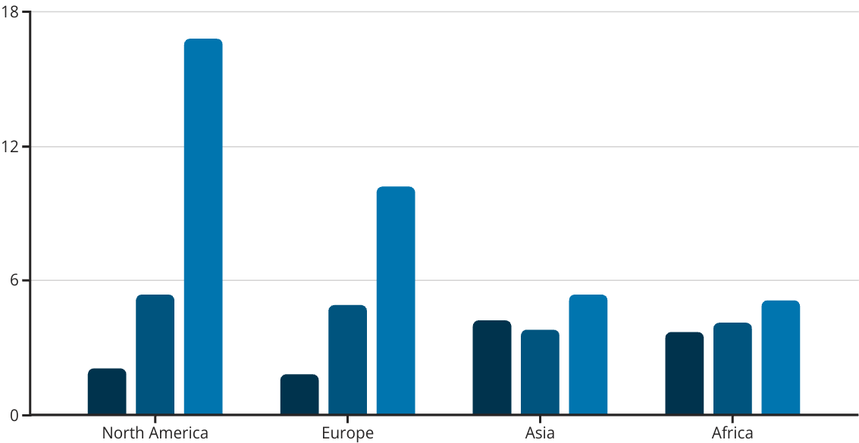
Bar Chart Comparisons
GDP Growth %
Education %
Health %

Slide 13
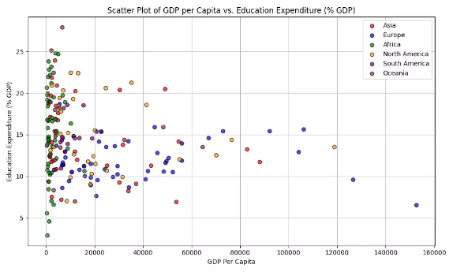
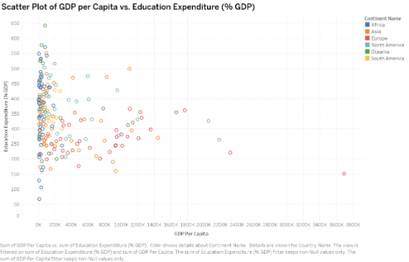
Scatter Plot Relationships
GDP vs. Education
Health vs. Development
Strong positive correlation between GDP per capita and education expenditure. Higher-income nations typically invest more in education systems.
Healthcare spending strongly correlates with economic development. The relationship forms distinct regional clusters in the data.

Slide 14
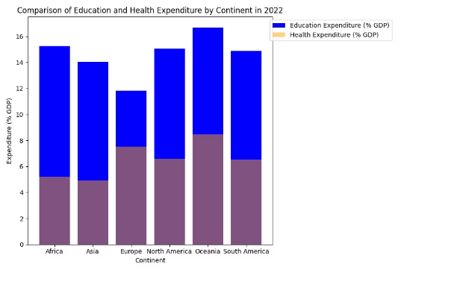




Comparing Expenditures
Education Spending
Healthcare Investment
Varies significantly by region, with developed nations averaging 5.2% of GDP
1
Ranges from 3.1% to 16.8% of GDP across
different regions
Growth Correlation
Regional Disparities
Both metrics show positive relationship with
economic development
Greatest in healthcare, with 5x difference between highest and lowest regions

Slide 15
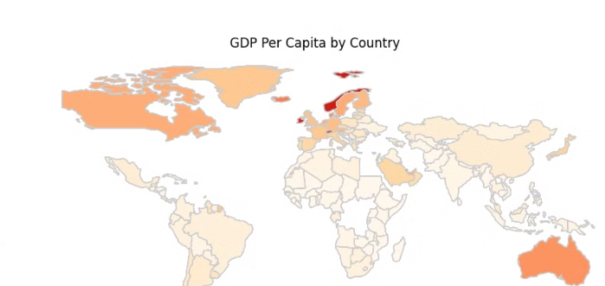
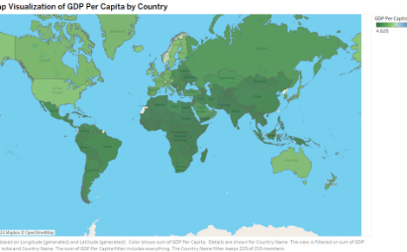
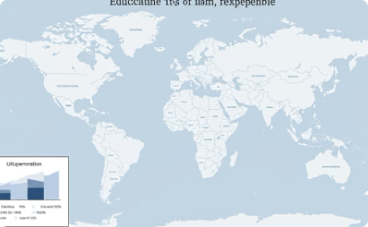
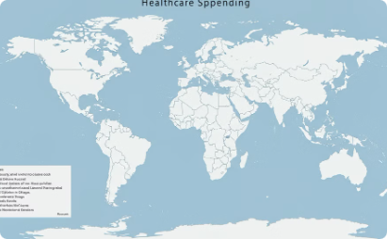
Geographic Patterns
GDP Per Capita
Education Investment
Healthcare Allocation
Map reveals stark economic divisions between global north and south regions.
Geographic visualization shows education spending hotspots across continents.
Spatial analysis reveals healthcare spending clusters in developed economies.

Slide 16





Conclusion
Targeted Assistance
Focus development efforts on regions showing greatest need.
Human Capital Investment
Education and healthcare spending strongly correlate with growth.
Policy Coordination
Implement balanced policies promoting sustainable development.
Continued Monitoring
Track economic indicators to measure progress and adjust strategies.

Slide 17

Link the Dataset - Dataset

